Slide 1
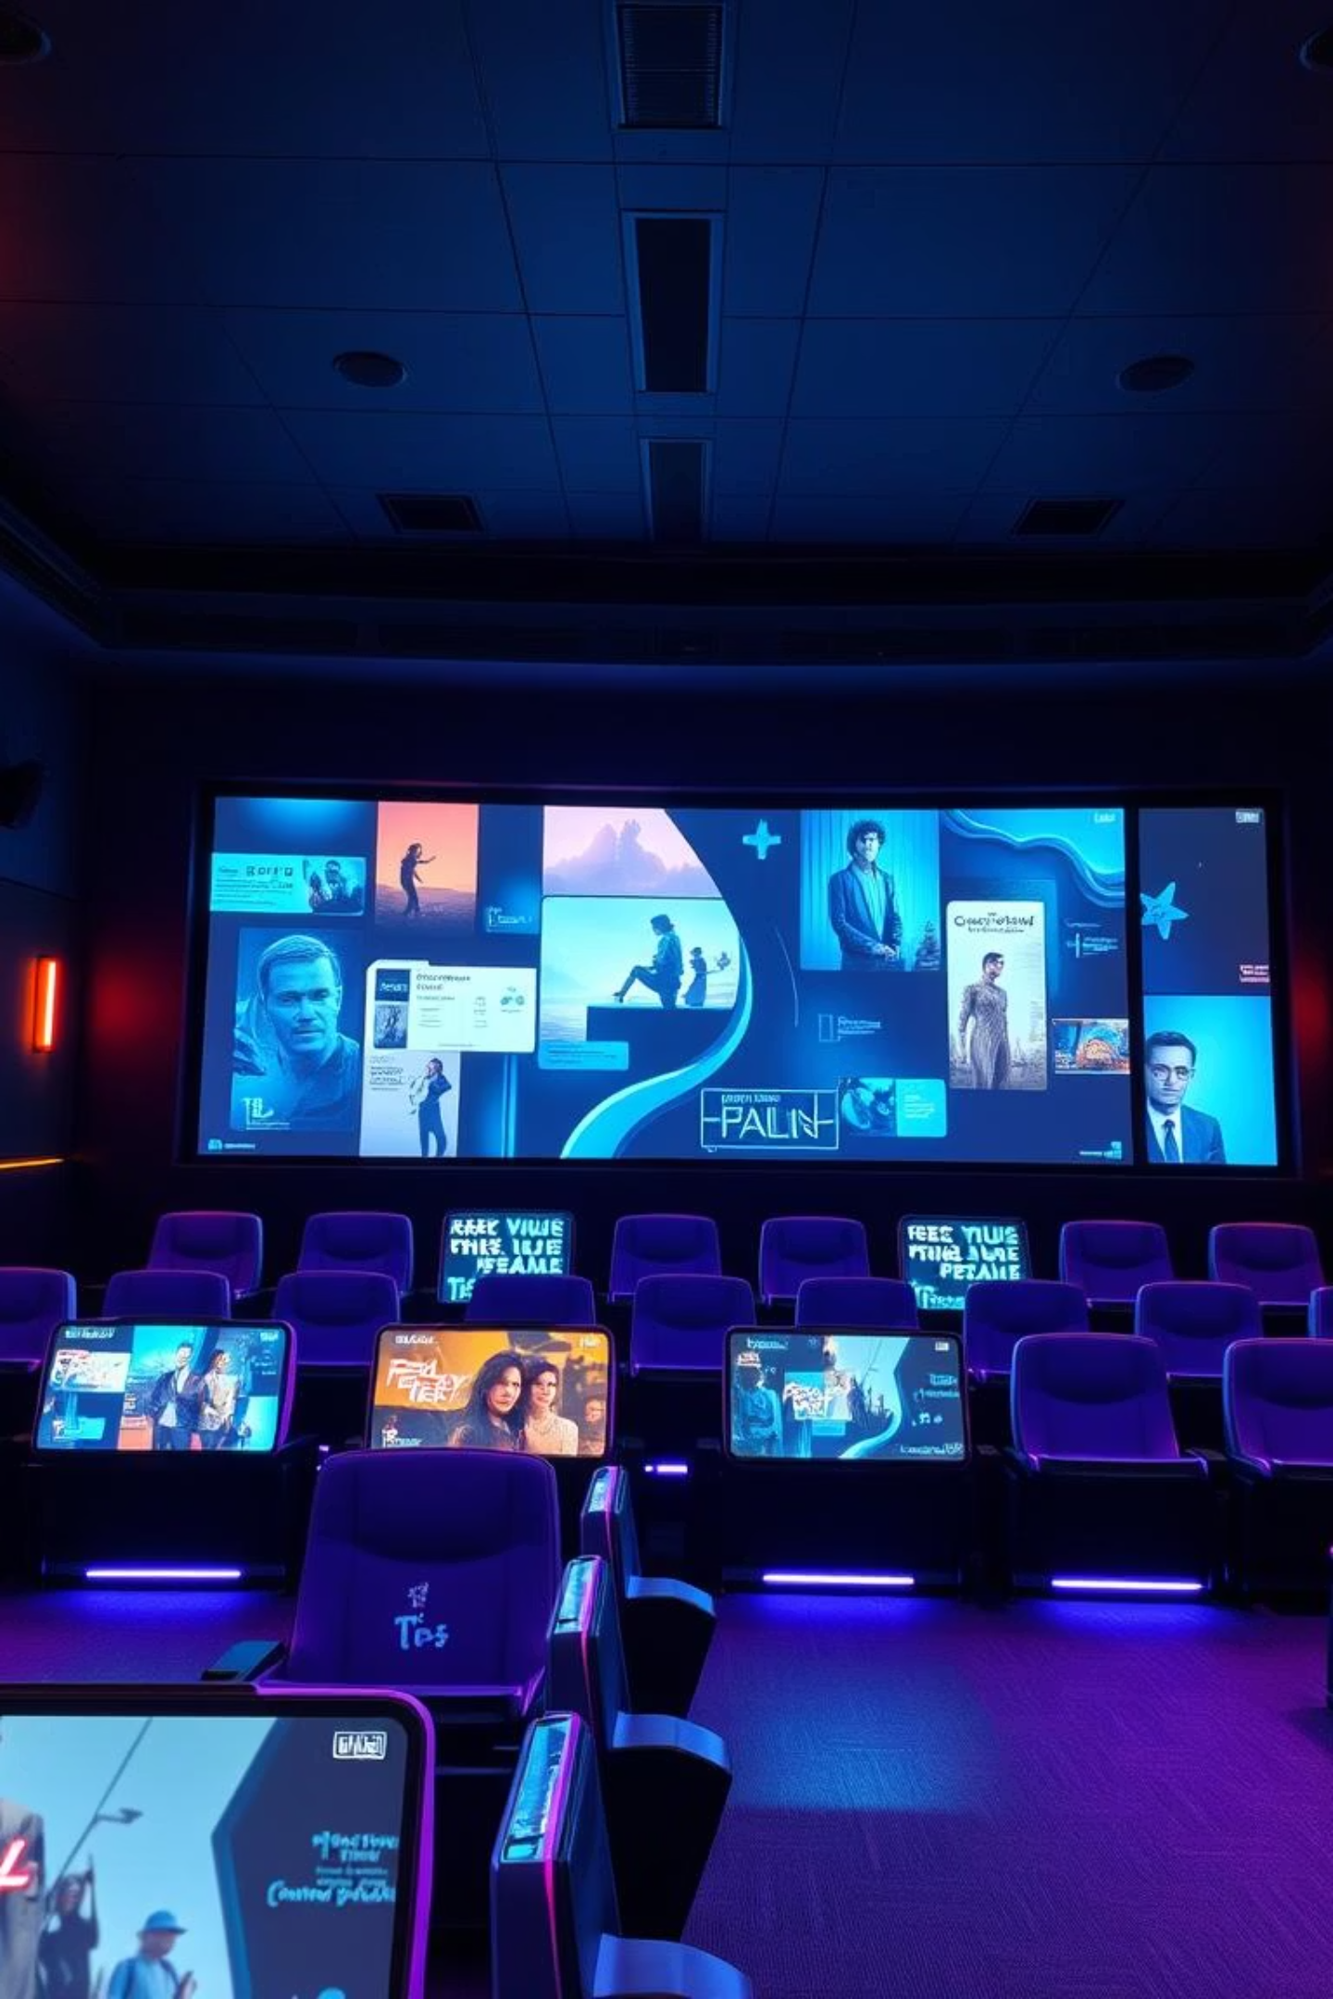
AI-Based Movie Recommendation System
This system recommends movies to users. It leverages AI and machine learning models. This enhances user experience and engagement.

Slide 2
Meet Our Dedicated Team
Behind this innovative AI-based movie recommendation system is a dedicated team of professionals whose combined expertise brought this project to life.
Tasmim Mustary - 011221193
Rahat Ahmed Shafi - 011221201
Md Sazim Ahamed Safim – 0112211321
Their collective effort ensures a robust and user-friendly solution for enhanced movie discovery.

Slide 3

Understanding the Core Concept
Our system leverages advanced AI and machine learning algorithms to analyze user preferences and provide highly accurate movie recommendations. It's designed to evolve with your tastes.

Slide 4


Leveraging Key Technologies
Built with powerful Python libraries, including Scikit-learn for machine learning models and Pandas for robust data handling.
This AI-based movie recommendation system uses Streamlit to provide real-time, personalized suggestions based on user input. It applies machine learning models on the MovieLens dataset using Python and Scikit-learn.

Slide 5


Diverse Recommendation Approaches
Content-Based Filtering
Recommends films similar to those you've enjoyed, analyzing genres and actors.

Slide 6
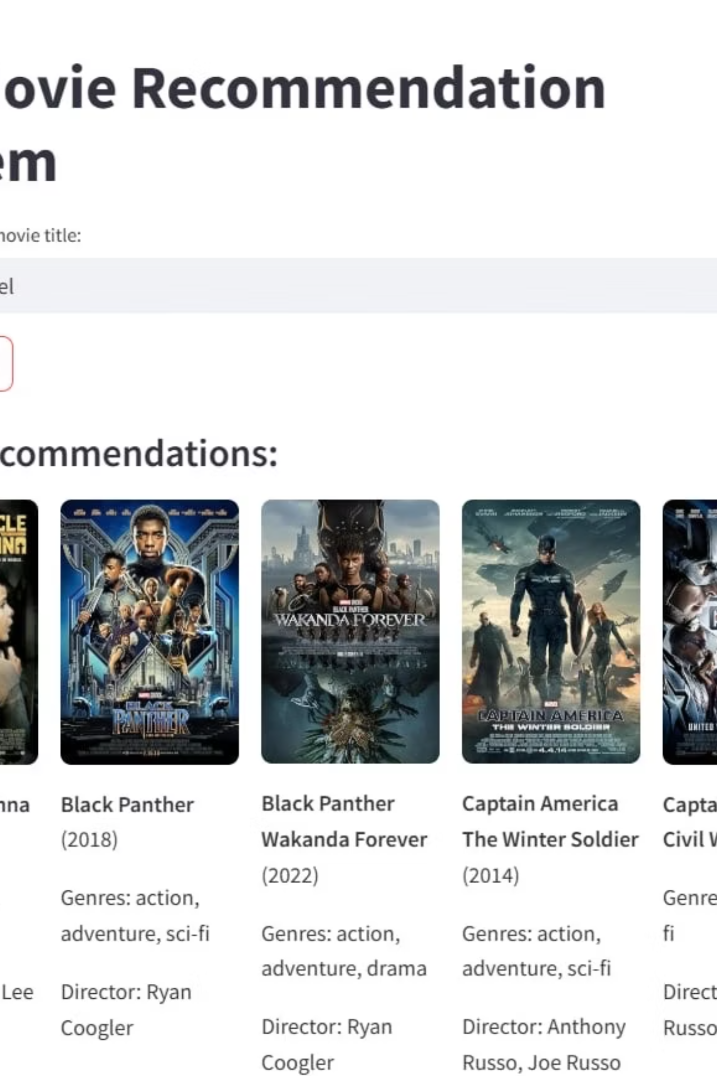
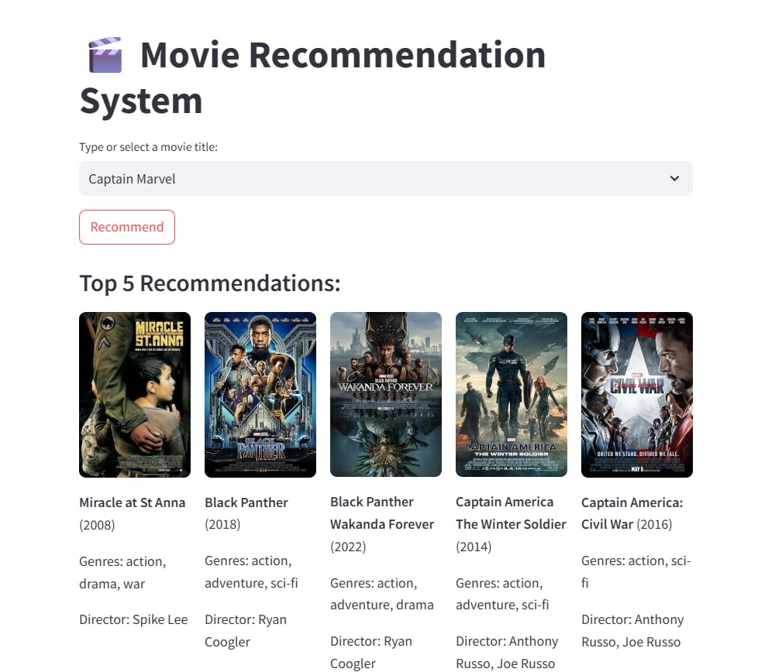
The MovieLens Dataset
Our system is trained on the comprehensive MovieLens dataset, a widely recognized benchmark for movie recommendation research. This robust dataset ensures high-quality suggestions.

Slide 7
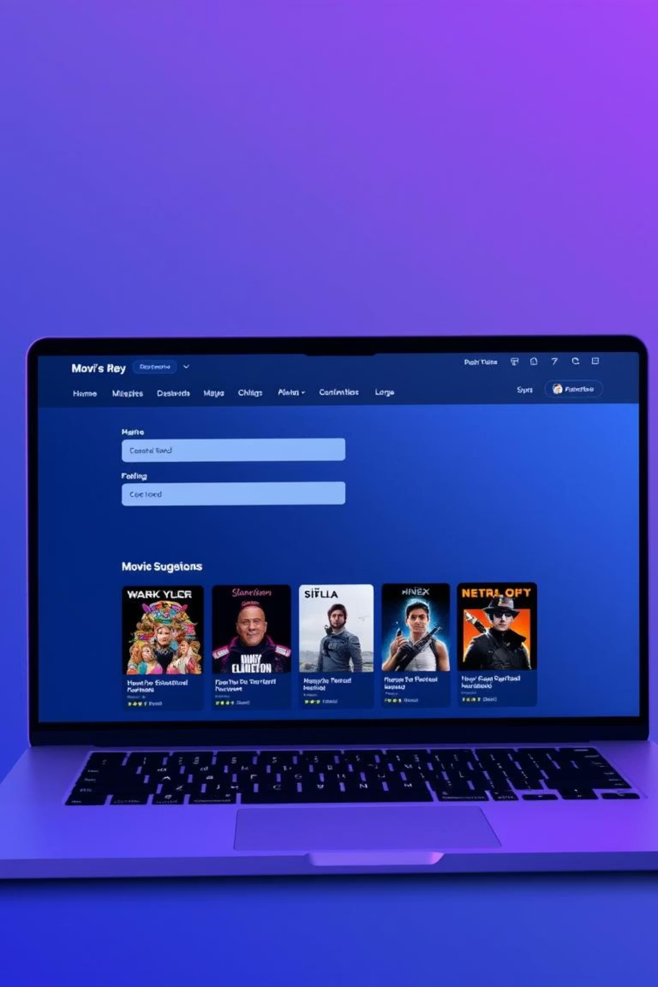
User-Friendly Web Interface
Users can easily input their preferences through a simple web interface, receiving instant, personalized movie suggestions for an enhanced viewing experience.

Slide 8

Future Enhancements
Real-Time Feedback
Implement continuous learning from user interactions for evolving recommendations.
Expanded Datasets
Integrate more diverse movie data sources to broaden the recommendation scope.
Advanced Features
Explore sentiment analysis and contextual recommendations for deeper personalization.

Slide 9

Ready for Deployment & Impact
This AI-based movie recommendation system is fully developed and ready for deployment, promising to revolutionize how users discover their next favorite film.

